Slide 1

THE FILSPAY
INVESTIGATION
CASE FP-2026 / FILE 01
FILSPAY
THE HANDOVER / CASE FILE
CLASSIFICATION: CONFIDENTIAL
CASE FILE / FINAL REPORT
CONFIDENTIAL
ASSIGNED OFFICERS
01
[MEMBER NAME]
OWNED: [AREA OF OWNERSHIP]
02
[MEMBER NAME]
OWNED: [AREA OF OWNERSHIP]
Everything in this file is evidence.
[MEMBER NAME]
03
OWNED: [AREA OF OWNERSHIP]
04
[MEMBER NAME]
TEAM: [TEAM NAME]
OWNED: [AREA OF OWNERSHIP]
CASE NO. FP-2026
OPENED: 30.10.2026
STATUS: INVESTIGATION COMPLETE
Notes:
Open on the stamp: the judges are looking at a confidential case file. Replace the bracketed placeholders with the real team name, member names and what each person owned. Add or remove officer cards to match the team size.

Slide 2

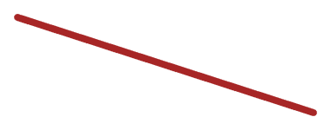
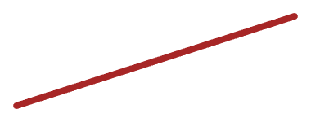
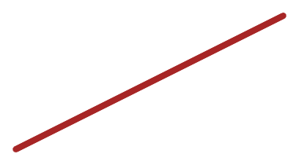
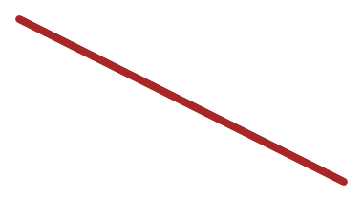
THE ROOT CAUSE
FILSPAY
THE HANDOVER / CASE FILE
CASE NO. FP-2026 · EVIDENCE 02 · 30.10.2026
THESE WERE NOT RANDOM BUGS.
THEY WERE CONNECTED.
What was actually going wrong?
FP-[___]
FP-[___]
[SYMPTOM TITLE]
[SYMPTOM TITLE]
EVIDENCE: [REF]
EVIDENCE: [REF]
ROOT CAUSE / FINDING 00
[ONE-SENTENCE ROOT CAUSE: the single underlying technical problem]
SOURCE: [COMMIT / LOG REF]
FP-[___]
FP-[___]
[SYMPTOM TITLE]
[SYMPTOM TITLE]
EVIDENCE: [REF]
EVIDENCE: [REF]
Notes:
One root cause, several symptoms. State the root cause in a single sentence, then name each symptom card with its ticket ID and evidence reference. The point to land: these were not random bugs, they were connected. All bracketed text is a placeholder until real findings are supplied.

Slide 3
WHAT WE FOUND
CASE FP-2026 · EVIDENCE 03 · 30.10.2026
FILSPAY
THE HANDOVER / CASE FILE
ranked by impact, highest first
[CRITICAL]
EVIDENCE 01
EVIDENCE 02
[HIGH]
[FINDING TITLE]
[FINDING TITLE]
[One-line evidence.]
PROOF: [REF]
Impact: [CRITICAL]
[One-line evidence: what the system did that it should not have.]
EVIDENCE 03
[HIGH]
PROOF:
[FINDING TITLE]
[One-line evidence.]
PROOF: [REF]
[PROOF: TEST / SCREENSHOT / LOG REFERENCE]
EVIDENCE 04
[MEDIUM]
[FINDING TITLE]
[One-line evidence.]
PROOF: [REF]
Notes:
Keep this to the top three or four findings, ranked by impact. Each card needs a finding title, a severity, one line of evidence and a proof reference such as a test, screenshot or log. Severity labels in brackets are placeholders; set them from the real findings.

Slide 4

WE DIDN’T JUST FIND IT.
WE FIXED IT.
FILSPAY
THE HANDOVER / CASE FILE
CASE NO. FP-2026 · EVIDENCE 04 · 30.10.2026
BEFORE 01
FIX 01
[IMG]
PROOF 01
VERIFIED
[What was broken: observed behavior]
[What changed: the fix made]
[Test / log / query result]
BEFORE 02
FIX 02
[IMG]
PROOF 02
VERIFIED
[What was broken: observed behavior]
[What changed: the fix made]
[Test / log / query result]
BEFORE 03
FIX 03
[IMG]
PROOF 03
VERIFIED
[What was broken: observed behavior]
[What changed: the fix made]
[Test / log / query result]
Notes:
Walk each row left to right: before, fix, proof. Use two or three major fixes. Delete the VERIFIED stamp on any row where real proof (test, log, query result or screenshot) has not been attached yet. Bracketed text and [IMG] frames are placeholders.

Slide 5
CASE REPRODUCTION
CASE FP-2026 · EVIDENCE 05 · 30.10.2026
FILSPAY
THE HANDOVER / CASE FILE
Live end-to-end proof.
01
CREATE PAYMENT
[SCREENSHOT 01]
[SCREENSHOT 02]
02
COMPLETE PAYMENT
03
FULL REFUND
FIG. 01 / STEPS 01–02
FIG. 02 / STEPS 03–04
04
PARTIAL REFUND
[SCREENSHOT 03]
BACKUP EVIDENCE
05
VERIFY DASHBOARD
[RECORDED RUN / SCREENSHOT SET: SEE APPENDIX A5]
06
VERIFY SETTLEMENT
FIG. 03 / STEPS 05–06
Notes:
Leave this slide up during the live demo and tick the boxes as each step passes. If the live run fails, switch to the backup evidence (recorded run or screenshot set) without comment and keep going. Screenshot frames are placeholders for real captures.

Slide 6
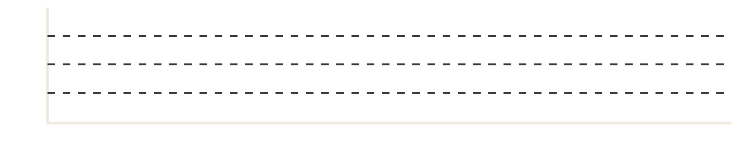


WHAT HAPPENS UNDER PRESSURE?
FILSPAY
THE HANDOVER / CASE FILE
CASE NO. FP-2026 · EVIDENCE 06 · 30.10.2026
FIG. 06-A / ARCHITECTURE
FIG. 06-B / LOAD TEST
[LAYER 1]
[LAYER 2]
[LAYER 3]
[DATA STORE]
BOTTLENECK IDENTIFIED HERE
[INSERT LOAD-TEST GRAPH]
SYSTEM RECOVERED
ESTIMATED CAPACITY
MEASURED CAPACITY
ERROR RATE
[X] USERS
[Y] USERS
[Z]%
BOTTLENECK
OVERLOAD BEHAVIOR
RECOVERY
[What saturated first.]
[What the system did past capacity.]
[How and how fast it recovered.]
Notes:
Report the measured numbers, not the estimates. Replace [X], [Y] and [Z] with real load-test results, replace the layer boxes with the real components, and insert the actual graph in the frame. The BOTTLENECK and RECOVERED annotations must point at the real points on the graph once it is in place.

Slide 7

AI WAS AN INVESTIGATION TOOL.
NOT THE JUDGE.
CASE FP-2026 · EVIDENCE 07 · 30.10.2026
FILSPAY
THE HANDOVER / CASE FILE
01
02
03
04
05
06
REPOSITORY
AI AGENTS
FINDINGS
HUMAN VERIFICATION
IMPLEMENTATION
TESTS
AI GOT THIS WRONG.
HOW WE CAUGHT IT
WHAT THE EVIDENCE ACTUALLY SHOWED
AI CONCLUSION
HUMAN CHECK
[The incorrect assumption or conclusion the AI proposed.]
[The check, test, query or log that contradicted the AI.]
EVIDENCE REF: [REF]
REJECTED
[What the code, data or test actually showed.]
Notes:
The message: humans verified AI output instead of trusting it. Pick one real case where the AI proposed something wrong, show the conclusion it reached, how the team caught it, and what the evidence actually showed. Bracketed text is a placeholder; do not present an example that did not actually happen.

Slide 8


CASE CLOSED?
FILSPAY
THE HANDOVER / CASE FILE
CASE NO. FP-2026 · EVIDENCE 08 · 30.10.2026
Not completely.
DECISIONS WE MADE
OPEN RISKS
FIXED
DEFERRED
[What was fixed + ref]
WHY: [reason it was left unchanged]
VERIFIED
REQUIRES MONITORING
[How it was proven + ref]
WHY: [what to watch and why]
PROTECTED
NEEDS PRODUCTION VALIDATION
[Guard or test that keeps it fixed]
WHY: [what could not be tested here]
DOCUMENTED
NEEDS FUTURE HARDENING
[Where the write-up lives]
WHY: [why it was out of scope]
WE DIDN’T TRY TO REWRITE FILSPAY.
WE MADE IT SAFER, MORE CORRECT,
AND EASIER TO TRUST.
CASE STATUS:
STABILIZED
Notes:
Close on the honest answer: the case is stabilized, not finished. For each open risk, say why it was intentionally left alone. End on the final statement. Bracketed text is a placeholder for the real decisions and risks.

Slide 9
TEST RESULTS
FILSPAY
THE HANDOVER / CASE FILE
CASE NO. FP-2026 · APPENDIX A1 · 30.10.2026
APPENDIX A1
TEST ID | WHAT IT PROVES | COMMAND / REF | RESULT
[TEST-01] | [Behavior verified] | [command / file] | [PASS / FAIL]
[TEST-02] | [Behavior verified] | [command / file] | [PASS / FAIL]
[TEST-03] | [Behavior verified] | [command / file] | [PASS / FAIL]
[TEST-04] | [Behavior verified] | [command / file] | [PASS / FAIL]
[TEST-05] | [Behavior verified] | [command / file] | [PASS / FAIL]
SOURCE OF TRUTH: [CI RUN / LOG LINK / DATE]
Notes:
Reusable layout for test results. One row per test: what it proves, how to reproduce it, and the actual result. Replace the placeholders with real runs only.

Slide 10
ARCHITECTURE AND LOAD-TEST GRAPH
FILSPAY
THE HANDOVER / CASE FILE
CASE NO. FP-2026 · APPENDIX A2 · 30.10.2026
APPENDIX A2
[INSERT ARCHITECTURE DIAGRAM]
[INSERT LOAD-TEST GRAPH]
FIG. A2-A / ARCHITECTURE: [SOURCE FILE / REF]
FIG. A2-B / LOAD TEST: [TOOL, DATE, RUN ID]
Notes:
Reusable layout for a full-size architecture diagram and a full-size load-test graph, each with a source caption so the judges can trace it.

Slide 11
SQL QUERIES AND LOGS
FILSPAY
THE HANDOVER / CASE FILE
CASE NO. FP-2026 · APPENDIX A3 · 30.10.2026
APPENDIX A3
PRINTOUT A3-A / SQL QUERY
PRINTOUT A3-B / LOG EXCERPT
-- [PASTE THE QUERY USED AS EVIDENCE]
[TIME] [LEVEL] [MESSAGE]
SELECT [columns]
[TIME] [LEVEL] [MESSAGE]
FROM [table]
[TIME] [LEVEL] [KEY EVIDENCE LINE]
WHERE [condition];
[TIME] [LEVEL] [MESSAGE]
-- RESULT: [ROWS / VALUE]
[TIME] [LEVEL] [MESSAGE]
Notes:
Reusable layout for a SQL query and a log excerpt. Highlight the one line that matters in red. Paste real queries and log lines only.

Slide 12
GIT EVIDENCE AND SECURITY FINDINGS
FILSPAY
THE HANDOVER / CASE FILE
CASE NO. FP-2026 · APPENDIX A4 · 30.10.2026
APPENDIX A4
PRINTOUT A4-A / GIT
PRINTOUT A4-B / SECURITY FINDINGS
ID | FINDING | SEVERITY | STATUS
[SEC-01] | [Finding] | [LEVEL] | [STATUS]
[SEC-02] | [Finding] | [LEVEL] | [STATUS]
[SEC-03] | [Finding] | [LEVEL] | [STATUS]
COMMIT: [HASH]
AUTHOR: [NAME]
DATE: [DATE]
MESSAGE: [COMMIT MESSAGE]
FILES CHANGED: [N]
DIFF: [LINK / SCREENSHOT]
Notes:
Reusable layout for git evidence (commit details) and security findings (ID, finding, severity, status). Fill in real commits and findings only.

Slide 13

BEFORE AND AFTER SCREENSHOTS
FILSPAY
THE HANDOVER / CASE FILE
CASE NO. FP-2026 · APPENDIX A5 · 30.10.2026
APPENDIX A5
BEFORE
AFTER
[SCREENSHOT: BEFORE THE FIX]
[SCREENSHOT: AFTER THE FIX]
REF: [FILE / DATE]
REF: [FILE / DATE]
Notes:
Reusable before/after layout. Also the place to keep the backup evidence for the live demo (recorded run or screenshot set).

Slide 14
AI TRANSCRIPT EVIDENCE
FILSPAY
THE HANDOVER / CASE FILE
CASE NO. FP-2026 · APPENDIX A6 · 30.10.2026
APPENDIX A6
PROMPT >
[Paste the prompt given to the AI.]
AI RESPONSE >
[Paste the AI response. Underline the incorrect claim in red.]
SESSION: [DATE / TOOL]
[THE INCORRECT CLAIM]
CHECKED BY: [NAME]
HUMAN CORRECTION >
EVIDENCE REF: [LOG / TEST]
[What the team found instead, with evidence ref.]
REJECTED. See Evidence 07.
Notes:
Reusable layout for an AI transcript: the prompt, the response, the incorrect claim highlighted, and the human correction with a reference. Use only a real transcript.

